Slide 1
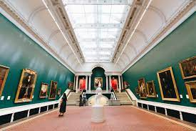
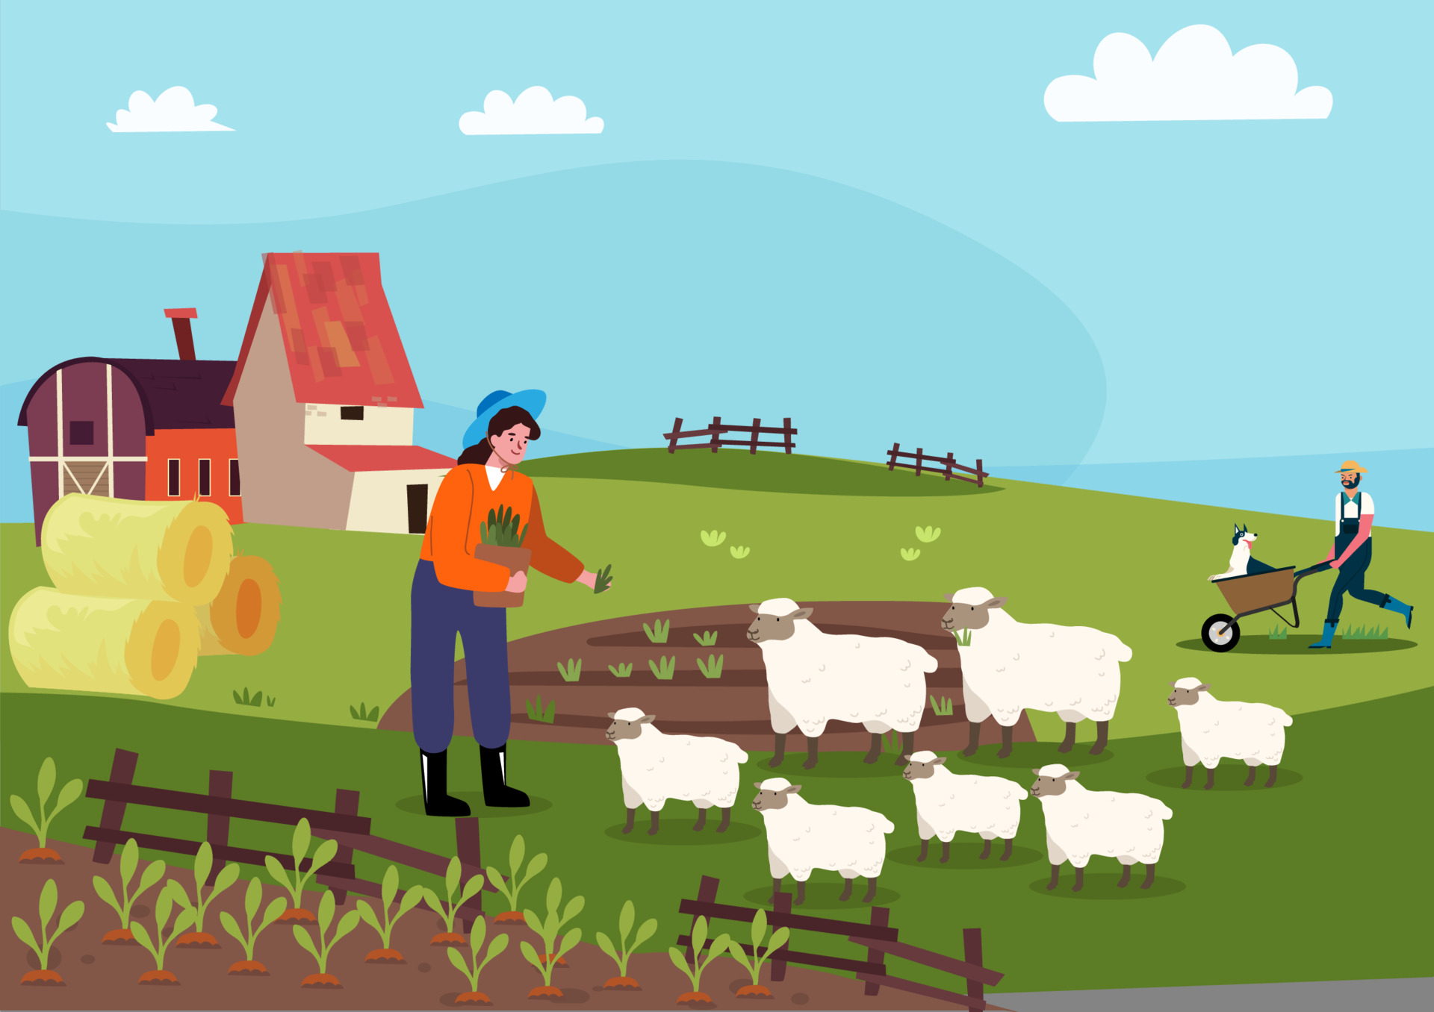




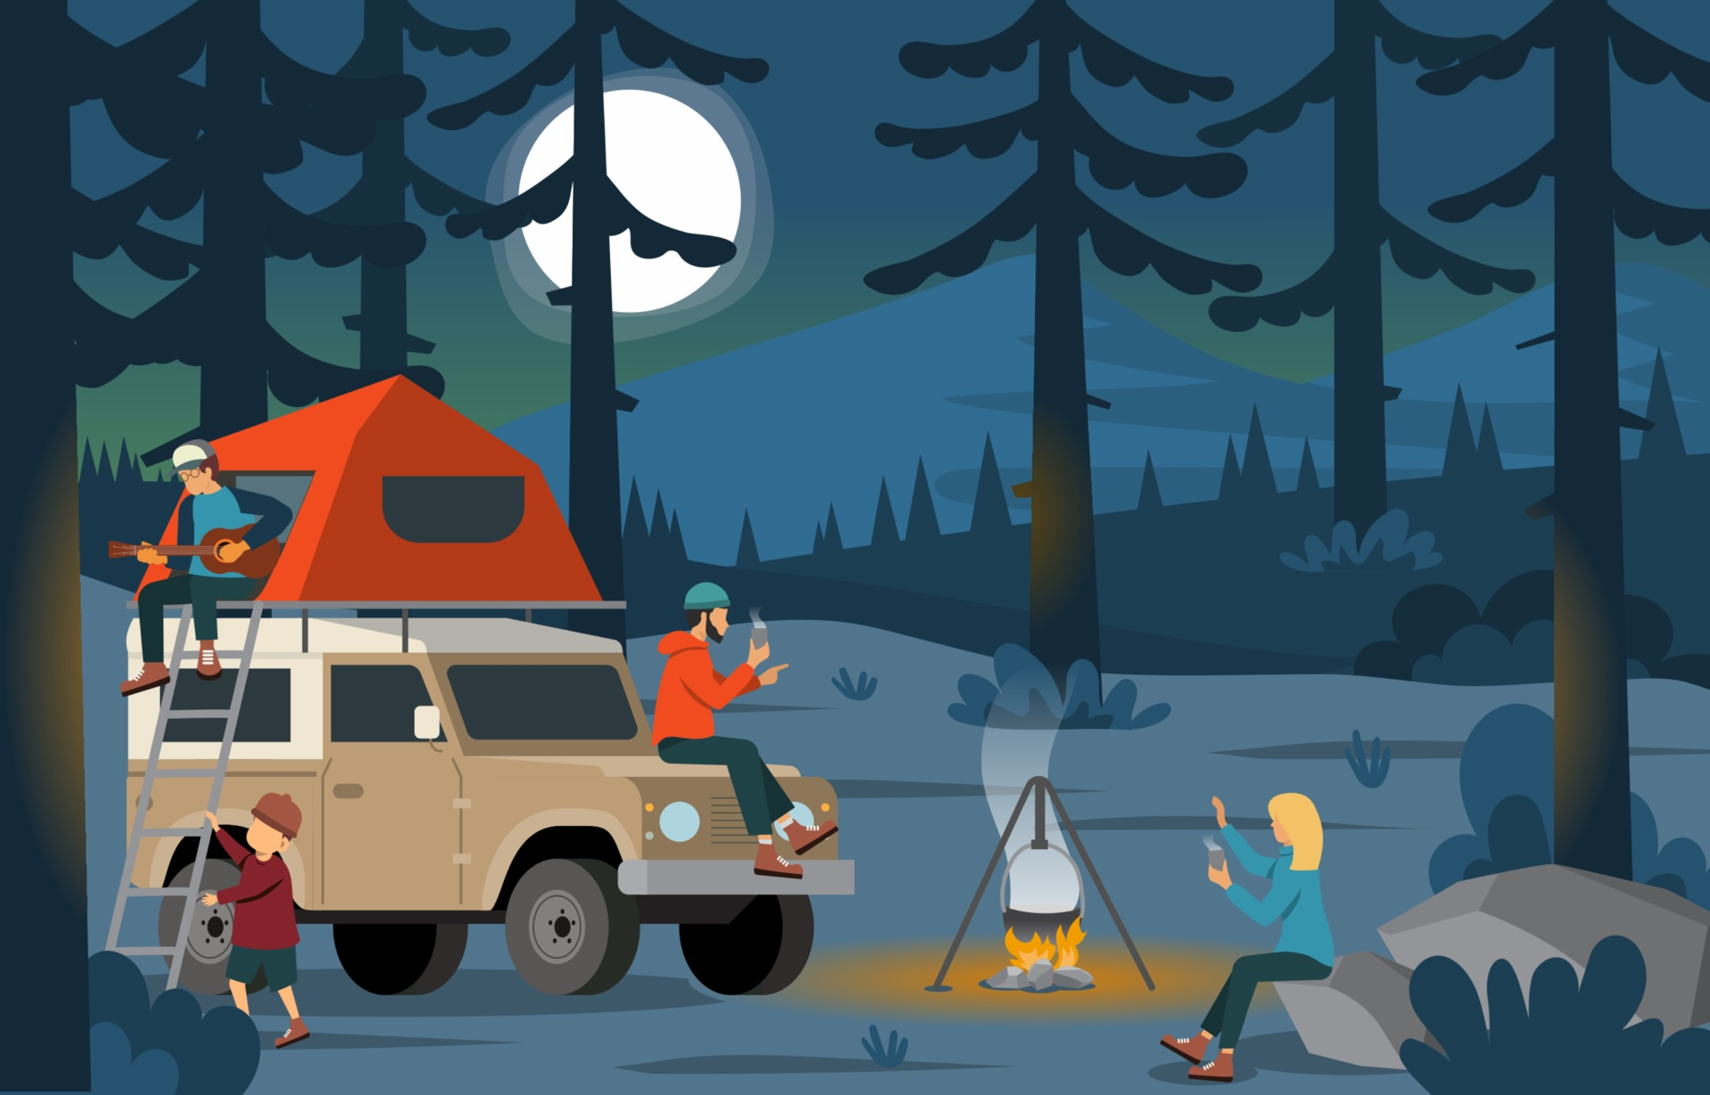
Trippr
A fun tool to assist your travel decision
Designed By:
Juanita, Tanav, Bryan, Keith, Eve

Slide 2
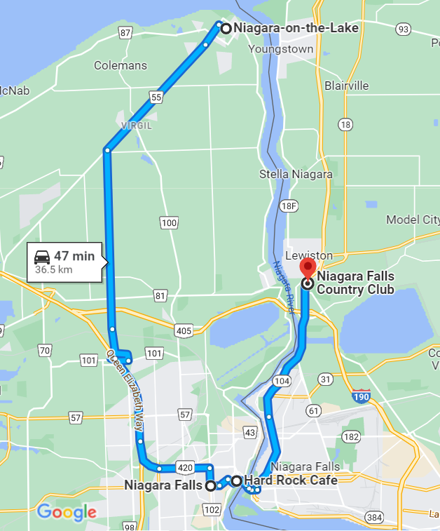
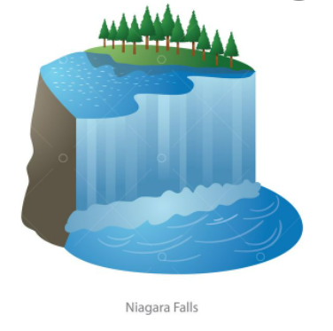
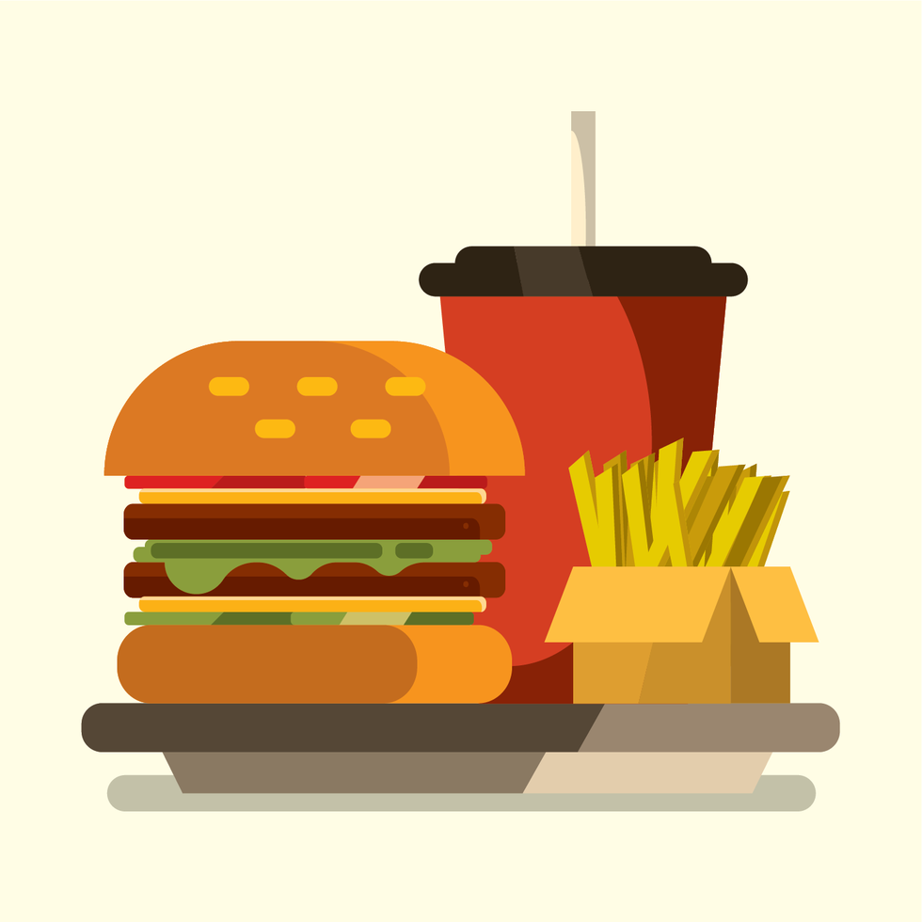
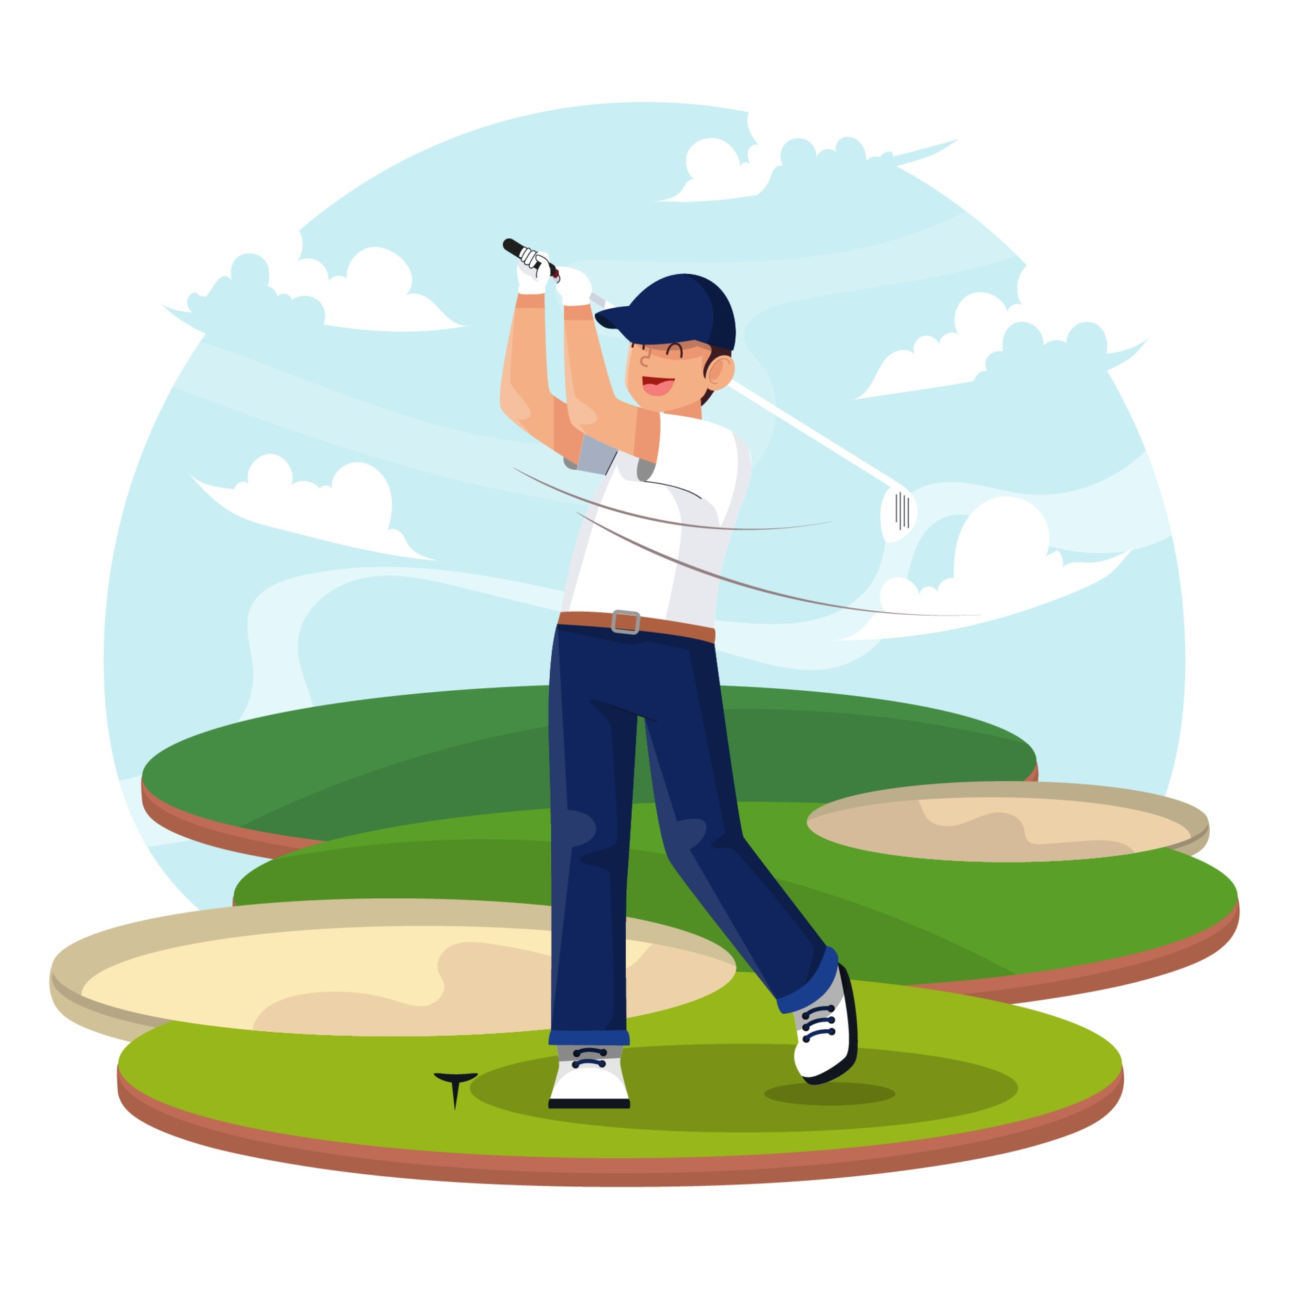
What is Trippr
What you will get:
Tell us how you are and we tell you what is your best next stop!
- First:
Tell us above yourself and where you will be.
- Second:
Trippr will give you 3 Top recommendations nearby.
- Last, but not the least:
Tell us which of the 3 your are more excited about!
Stop
Make your way to great pictures at Niagara Falls
Stop
Grab an amazing Burger and Fries at Hard Rock Café
Stop
Wrap your day with a Golf Game at the Niagara Falls Country Club
1
2
3
3
1
2

Slide 3

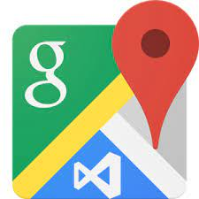




Resources and Technologies
Resources:
Google Map
Trip Advisor
Others (if possible)
Collecting User inputs
Technologies:

Slide 4
Our Team
Even Xu
Tanav Sharma
Bryan K
Keith McManamen
Juanita Camargo

Slide 5
Stage 1 | Front End | Step 1: User creates an account Step 2: User answers 10 questions about their preferences Step 3: User provides the location they will be at Example: If user goes to CN Tower + Niagara Falls + Hotel
Stage 2 | Back End | Check the Data Processing at a glance here
Stage 3 | Front End | Output 1: TRIPPR gives the User the Best Route to take along the Top 3 Best Recommendations around their location based on their interests. Example: if the user likes to be social and likes to go on adventures, the ML will recommend clubs and a hiking trail along the route Bonus: The User is asked to click on the most liked out of the 3 recommendations which goes back to our ML model to be fed so it learns

Slide 6
User Input
Database
User registration details
Loading and Cleaning Data
Google Reviews
Analysis
Average Rating Per Category
TripAdvisor Data
User 10 answers
User location
Categorizing Data
Clustering
Machine Learning
Predicting Recommendations with Kmean
ERD Prep
HTML
User Input
Tabular Data to JSON
HTML
User Output
User Input Data
User Output

Slide 7





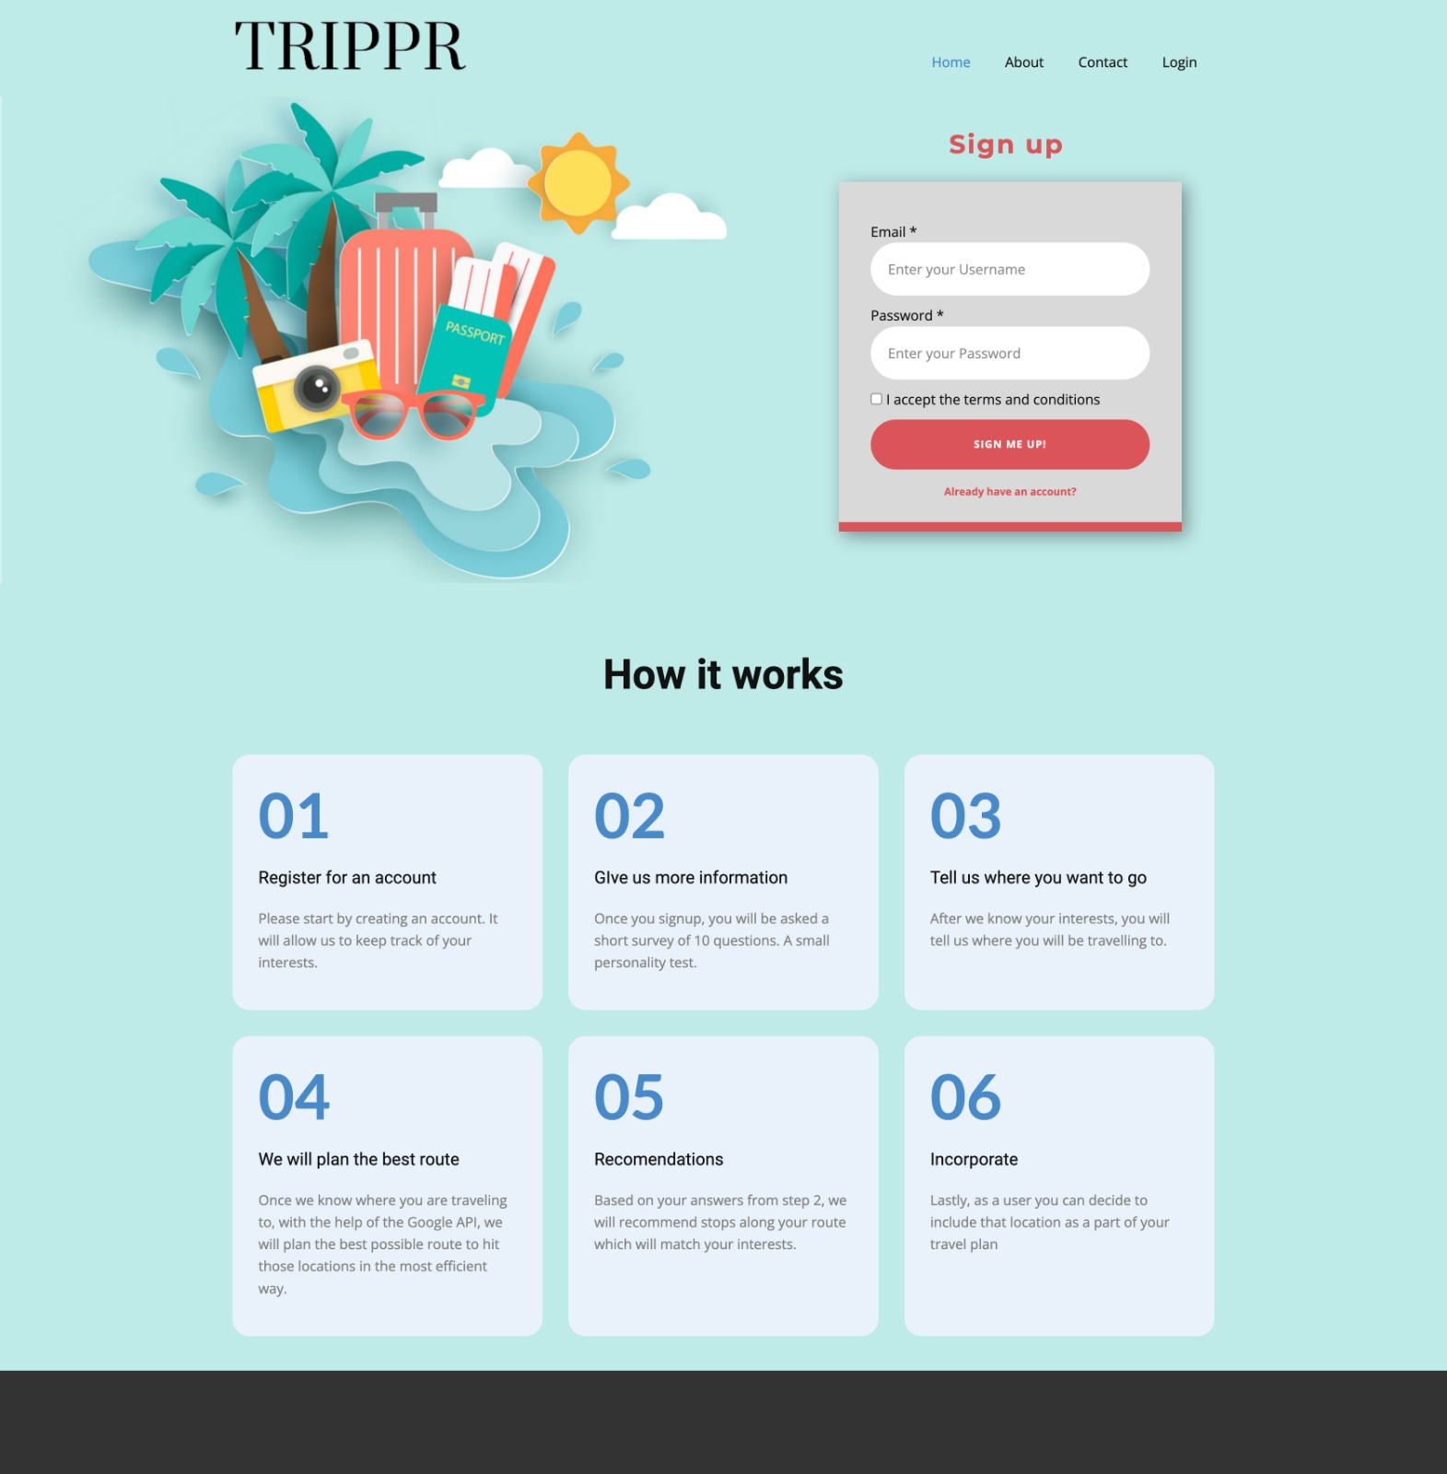
Process Flow and Diagram – Run Cluster model one time only
Initial Unsupervised Model – run one time only for now
Training Initial rating Data for cluster
isolated model and only run it when it’s necessary
Pull 3 categories and select top rated location
Cluster filter
Matrix Score to filter 3 categories
HTML
Input - User Registration
Input - User survey
Output - Gmap
Output - Recommendation
Research
HTML
Project Planning
Brain Storming
Research
Process Design
Data Download
ETL & Data Store
Data Profiling
Database Design
Load to DB
Data Store
Collect User Info
Store in database

Slide 8
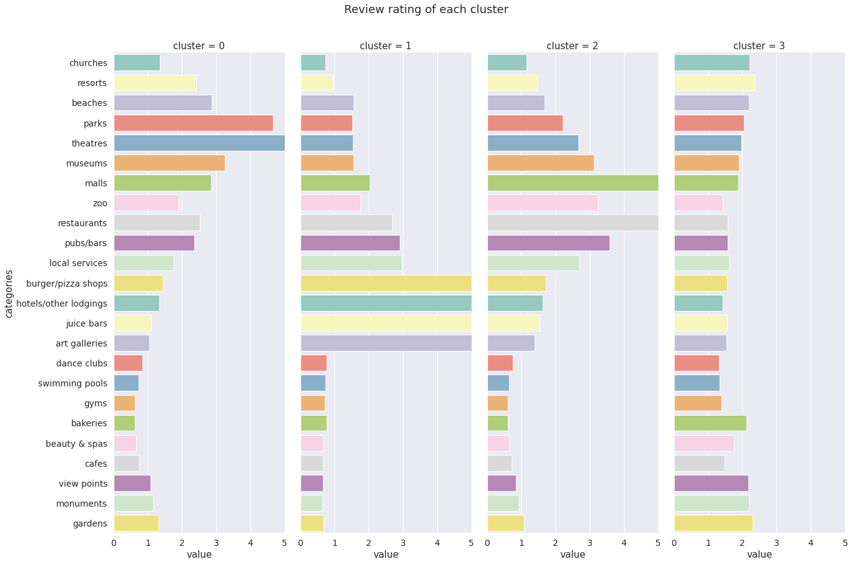
First – Run Clustering model Results(following is example)

Slide 9
Second - Cluster Decision based on the clustering model results
Clusters decision currently is a static table which will work as the first step filter to filter down the categories. Once user enters inputs, answers will decide which cluster they belongs to. We will use the categories within this specific cluster for next step filtering

Slide 10
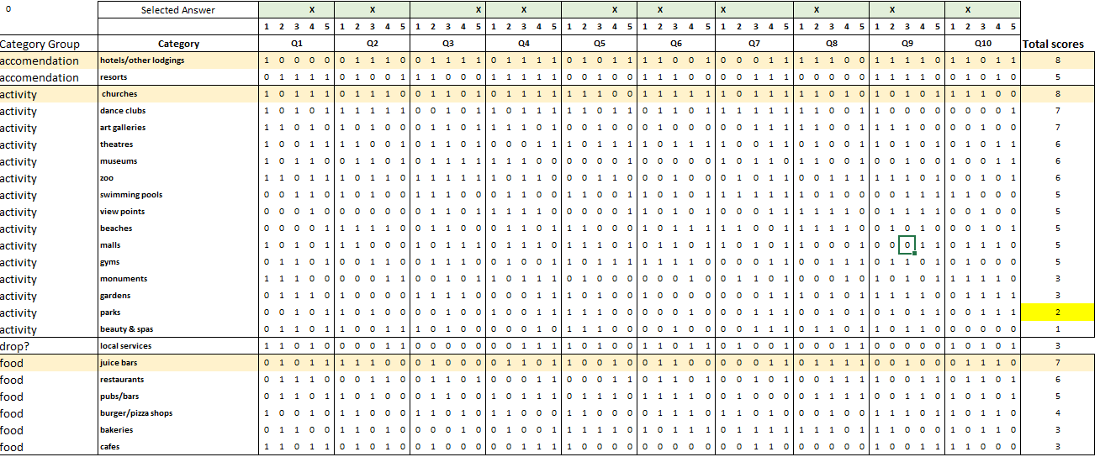
Third - Matrix Score to ranking the top 1 category in 3 bins
Matrix Score will decide which 3 categories will be selected for recommendation based on the score ranking in each category group (this is an example with dummy numbers)

Slide 11
Forth - Gmap or other tool to look 1 top rated locations in each category
The last step is once have 3 selected categories, we will pull the top rated locations in each category from G-map or other map service within 25 km around the location user has entered.

Slide 12
Front End – INPUT

Slide 13
Front End 10 questions for the User to answer
In a scale from 1 (less like you) to 5 (more like you) answer the following 10 questions:
You spend most of your time off exploring different topics that interest you
You are a yogi even when the house is on fire
At a party you just talk to those you know instead of talking to new people
You enjoy creating lists and using organizing tools for every layer of your life
You are keen to discuss interpretations of creative pieces
Never miss the chance of trekking a peak at sunrise
A stay at an all-inclusive resort by the beach
I go on vacation but keep up my training even at an indoor pool
Eating is an experience I enjoy at any fine dining restaurant
I go away to get good rest and a spa is always a good idea

Slide 14
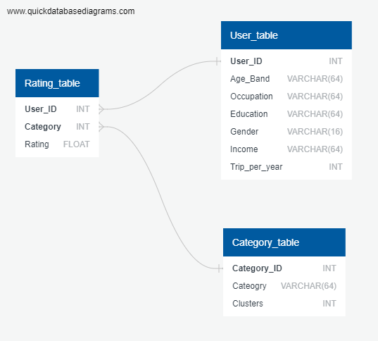
Database ERD (Preliminary)

Slide 15
ML Model Diagram
Database
Unsupervised ML Model
Input
Data Preparation
Scaling
Output
Rating Data
PCA Setting
Group data into clusters
Category Table
User Table
Find the best value for K
Plot data and Validation

Slide 16
Front End – OUTPUT
Stop 1:
Make your way to great pictures at Niagara Falls
Stop
Grab an amazing Burger and Fries at Hard Rock Café
Stop
Wrap your day with a Golf Game at the Niagara Falls Country Club
1
2
3
3
2
1
Tell us which of the above you are more excited about by clicking on the number!
We hope you enjoyed TRIPPR!

Slide 17
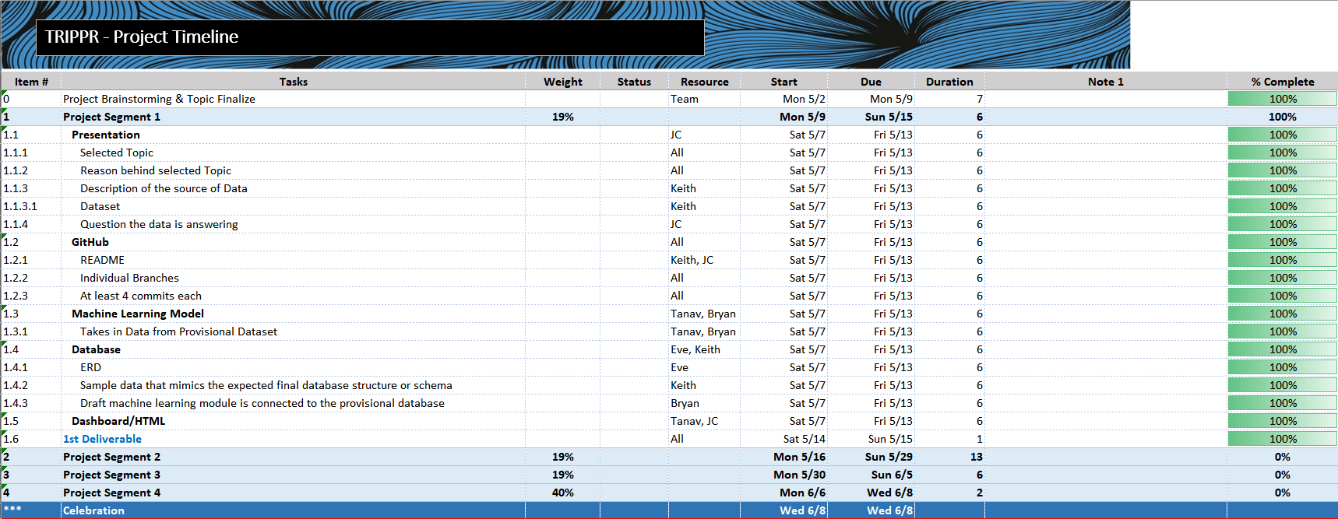
Project Timeline (1/4)
https://docs.google.com/spreadsheets/d/1KyWz_hvWlGAdM2UQH-obt4saGh2944SG3pFduIWhSfc/edit?usp=sharing

Slide 18
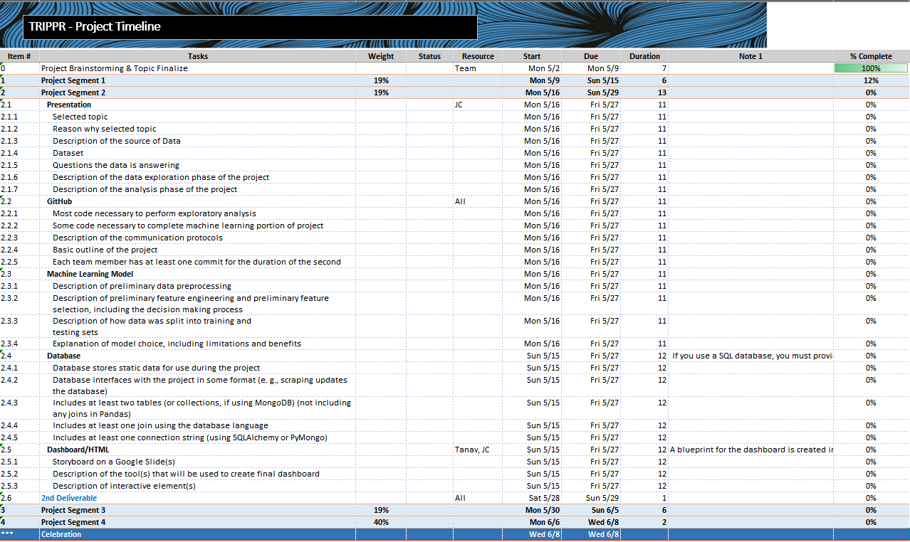
Project Timeline (2/4)
https://docs.google.com/spreadsheets/d/1KyWz_hvWlGAdM2UQH-obt4saGh2944SG3pFduIWhSfc/edit?usp=sharing

Slide 19
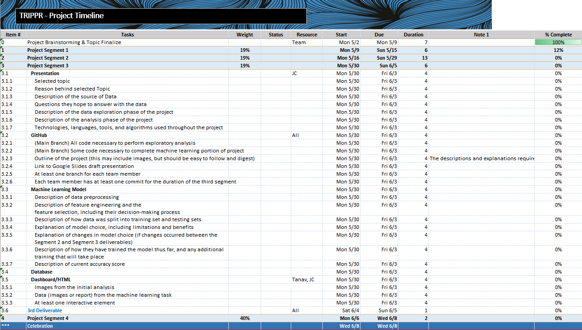
Project Timeline (3/4)
https://docs.google.com/spreadsheets/d/1KyWz_hvWlGAdM2UQH-obt4saGh2944SG3pFduIWhSfc/edit?usp=sharing

Slide 20
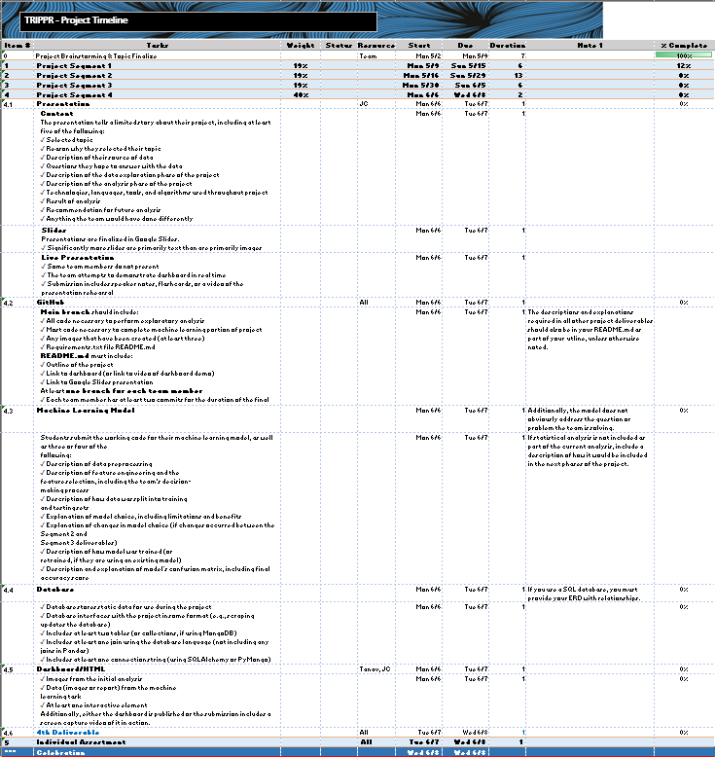
Project Timeline (4/4)
https://docs.google.com/spreadsheets/d/1KyWz_hvWlGAdM2UQH-obt4saGh2944SG3pFduIWhSfc/edit?usp=sharing

Slide 21
Google Slides
https://bit.ly/3FJNgXG

